Slide 1
ANDROID TRAINEE BATCH 4
Zaky Abdurrahman

Slide 2
Tentang Saya
Pendidikan
S1 Psikologi Universitas Diponegoro – Lulus 2023 IPK 3.49
Work Experience
Human Capital Intern – PT. Bina Karya (Persero) - 2022
Skills
Python, Kotlin, Web Development, Android Development, English, Japanese

Slide 3
Final Project : TokoPaErbe
Fitur
Authentication
Transaction
View Products
Wishlist
Cart
View Products
Notification
Tech Stack
Compose (in Fragment) + XML
Moshi + Retrofit
SharedPreferences
Dependency Injection (Hilt)
Room Database
Coroutines
Robolectric + Mockito (Testing)

Slide 4
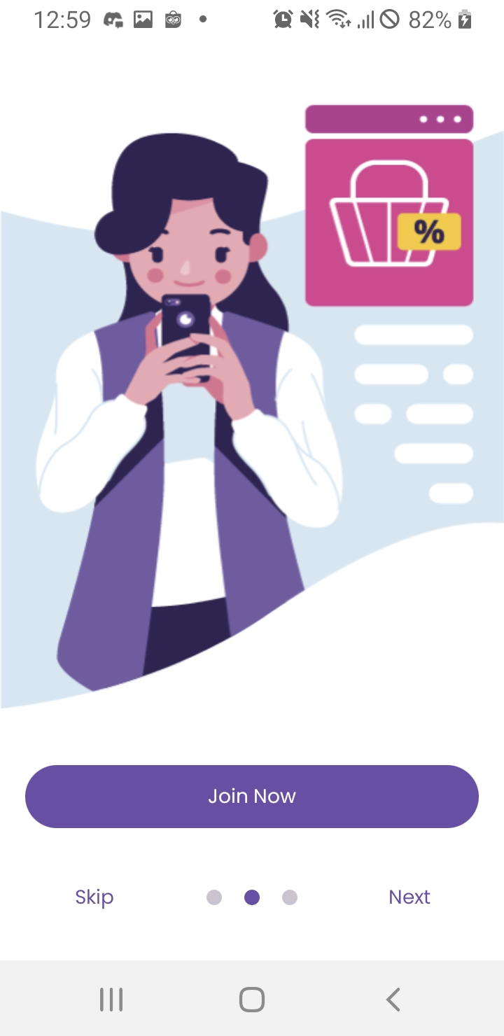
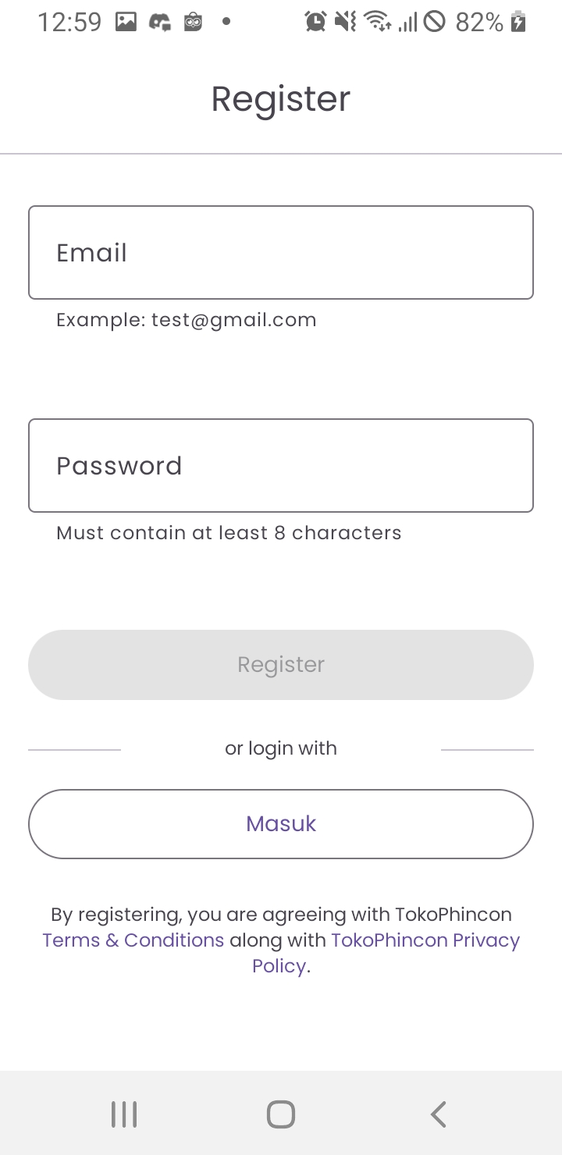
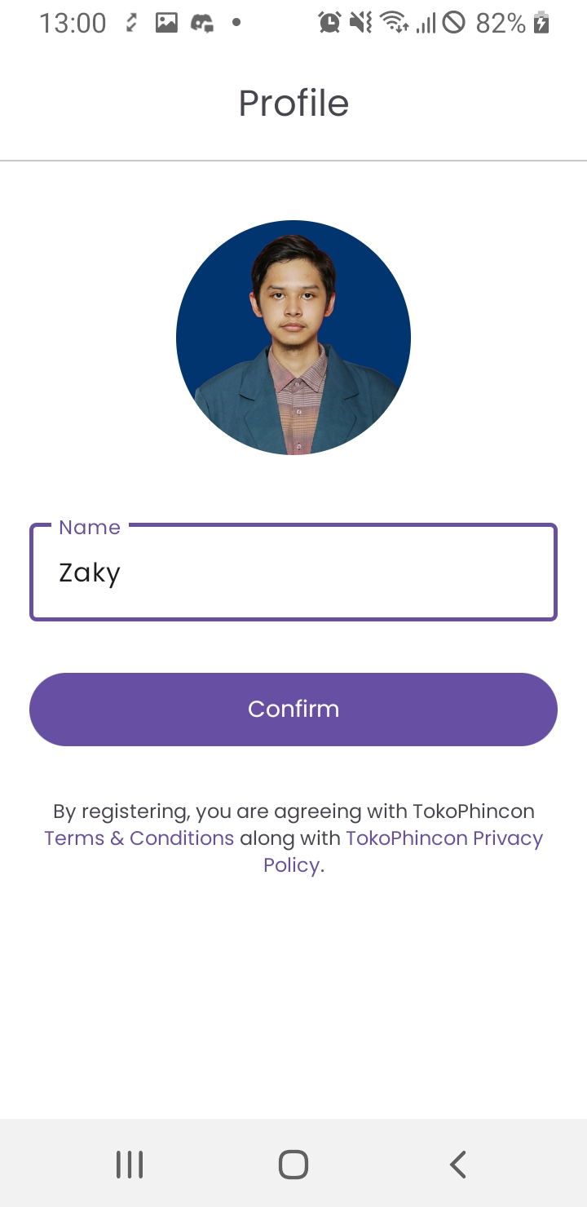
WEEK 1 : Prelogin
Splash Screen
Onboarding
Login
Register
Profile
App Navigation

Slide 5
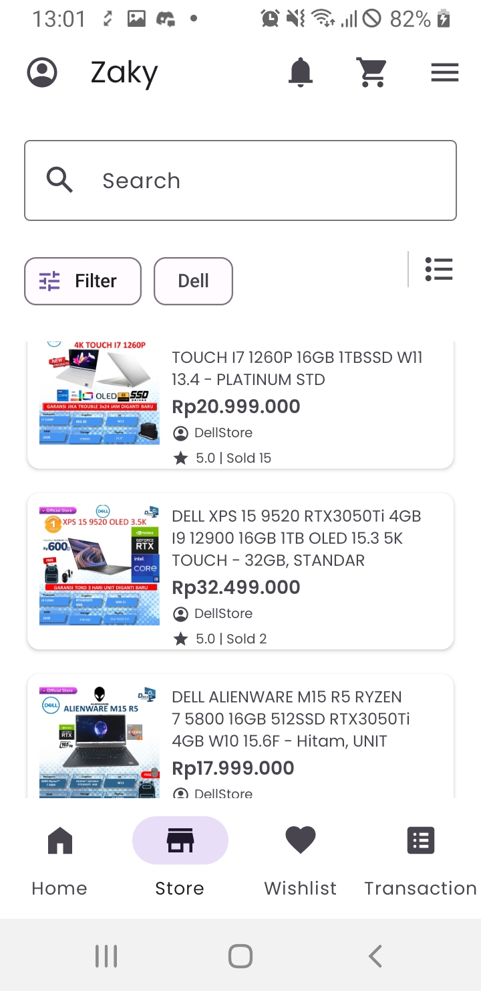
WEEK 2: Store
List Product (Grid and Linear)
Paging Adapter
Filter
Search
Loading and Error State

Slide 6
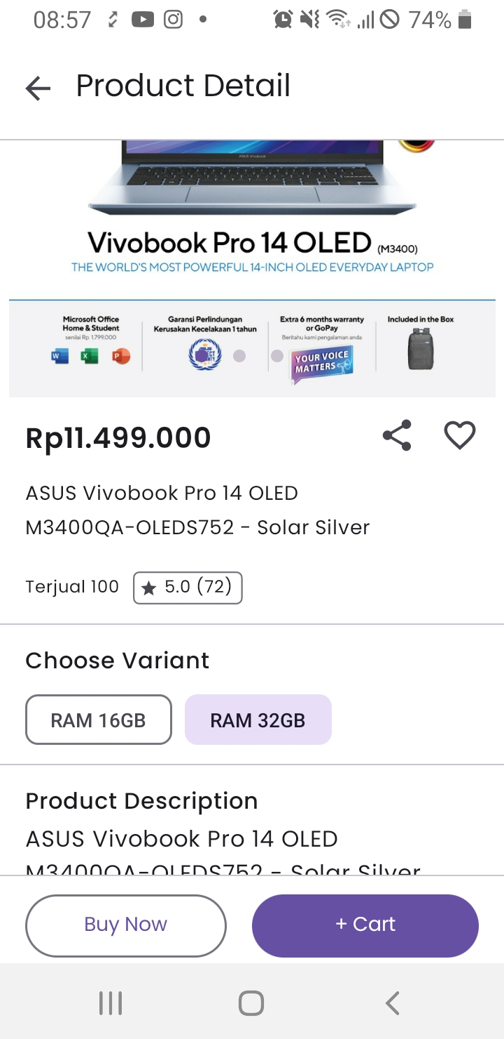
WEEK 3: Product Detail
Product Detail
Selecting Variant
See Product Review
DeepLink

Slide 7
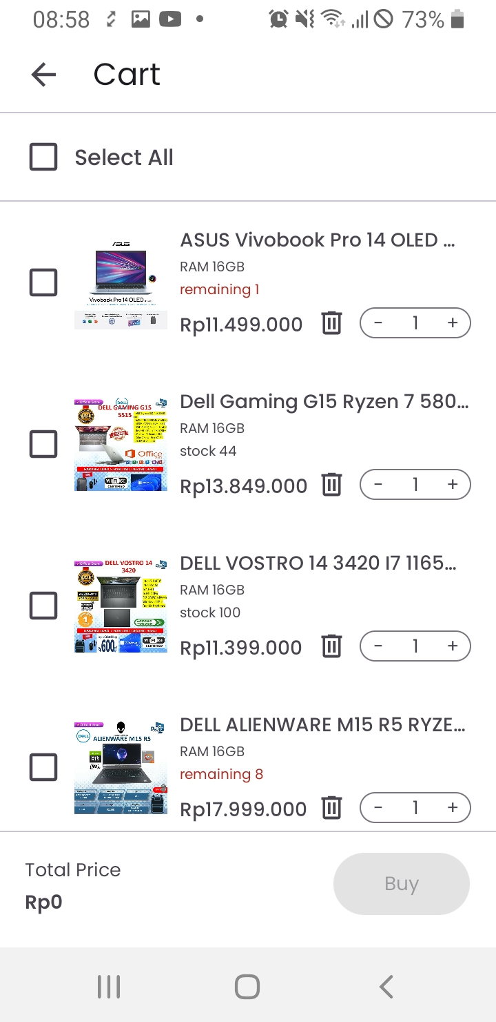
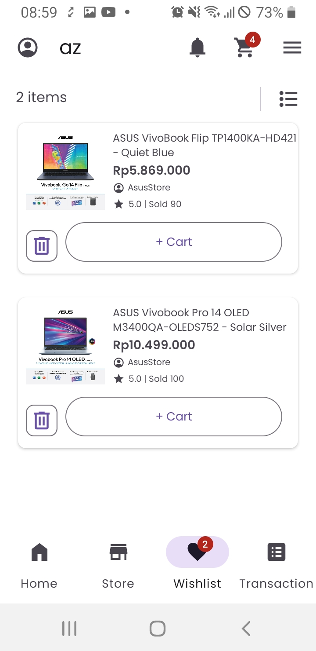
WEEK 4: Cart & Wishlist
Using Room Database
Cart
Wishlist
Adding Badge

Slide 8
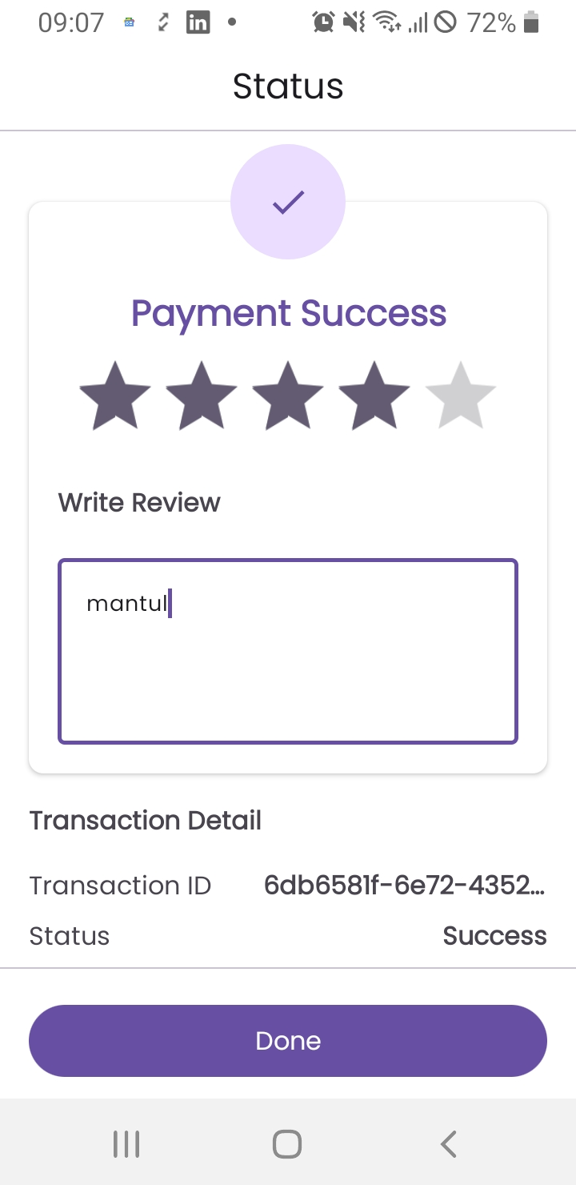
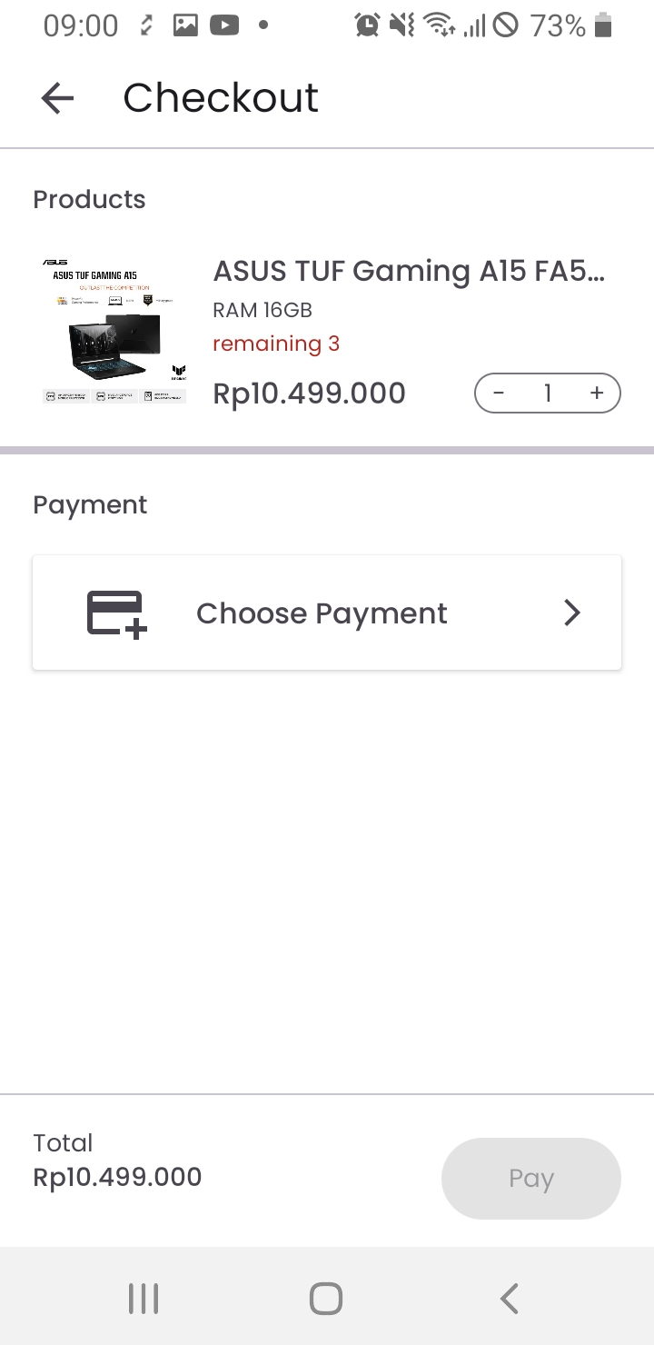
WEEK 5: Fulfillment
Checkout
Payment
Status
Transaction

Slide 9
WEEK 6: Jetpack Compose
Using Compose in Views
Migrate Views to Compose inside Fragment (Product Detail & Review)

Slide 10
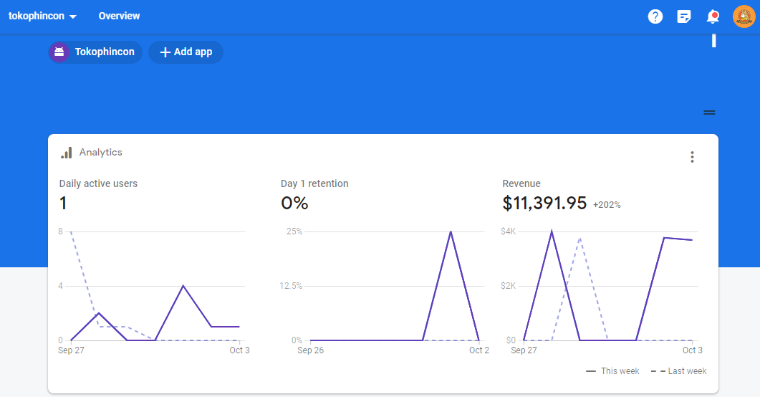
WEEK 7: Firebase
Push Notification using Firebase Cloud Messaging (FCM)
Crashlytics
Analytics (event logging)
Dynamic Layout, language and theme settings

Slide 11
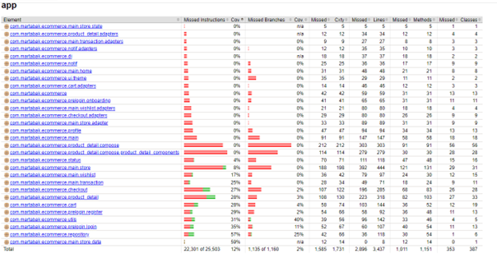
WEEK 8: Pre Deployment
Unit Testing (API, Repository, ViewModel, DAO)
Jacoco (code coverage)
Detekt (code smell analysis)
Configuring for Release (Proguard & Gradle)
Modularization

Slide 12
Obstacles & Solution
When refresh return 401, app infinitely call refresh token instead of logout
Make sure to not put authenticator on authenticator’s retrofit instance
Changing an object of a List clone also changed the original List
Also clone every object on the list because object is basically pointers
Release build will crash at startup
Set proguard to spare parcelizable class from obfuscation
Recycler view scroll position is reset when changing fragment
Save scroll position and y-offset on sharedpreference and restore it

Slide 13
Weakness
Never used Java
Laptop performance is very limited and only has 8 GB RAM (can’t run emulator)

Slide 14
Suggestions
Host server on a single machine instead of locally

Slide 15
THANK YOU

